Slide 1

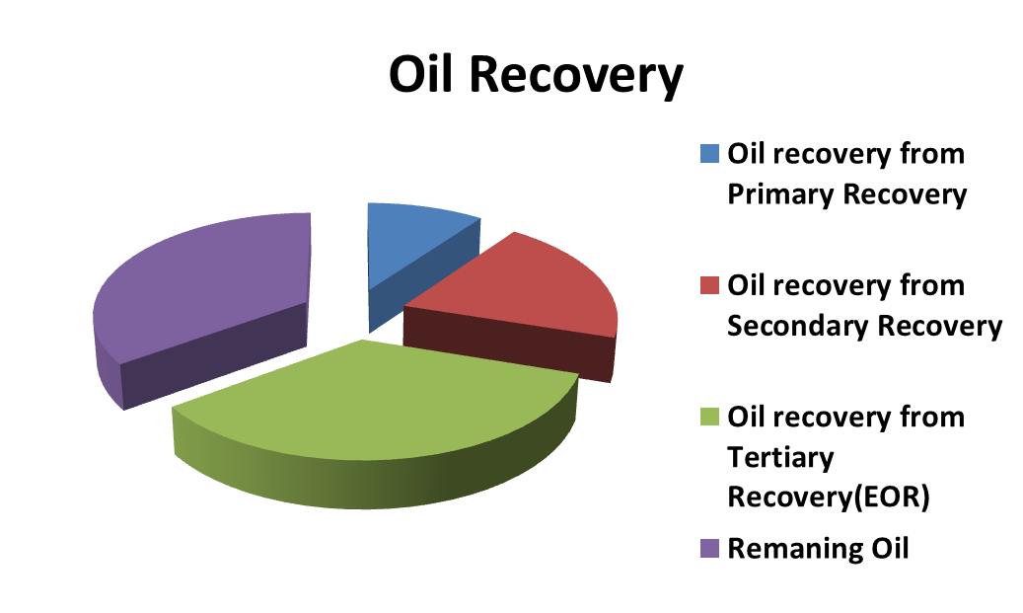
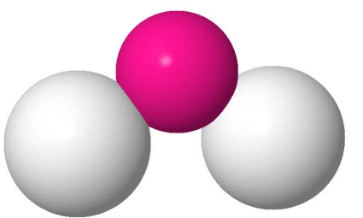
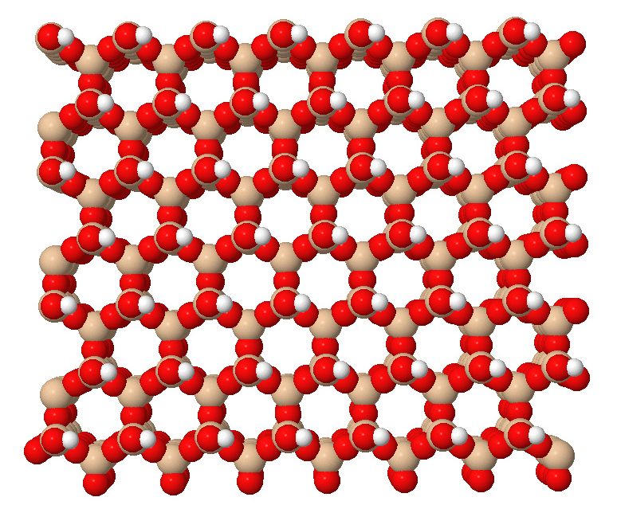
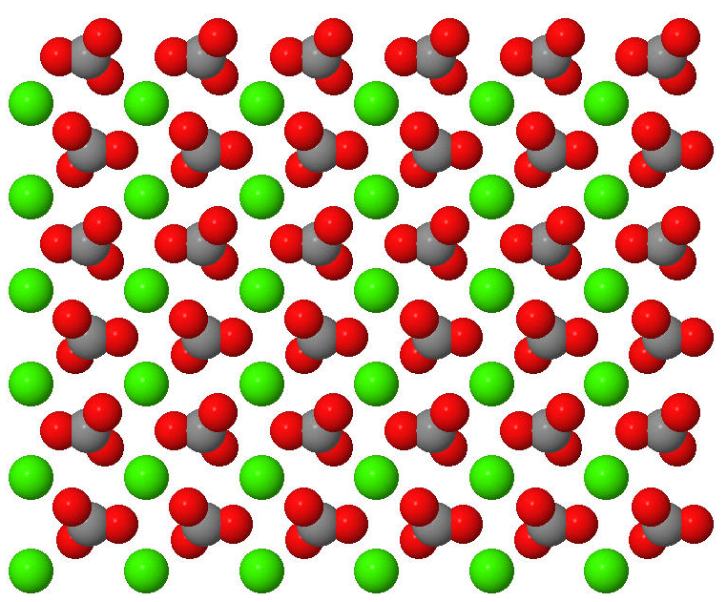
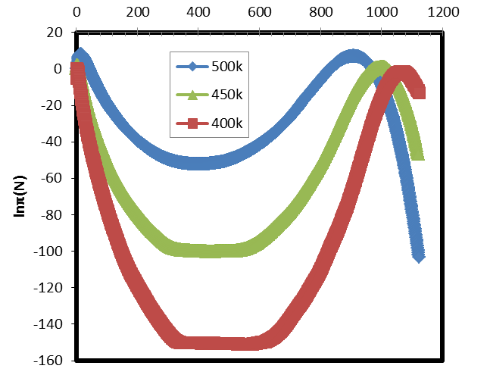
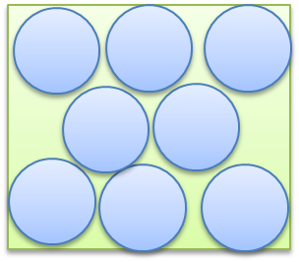
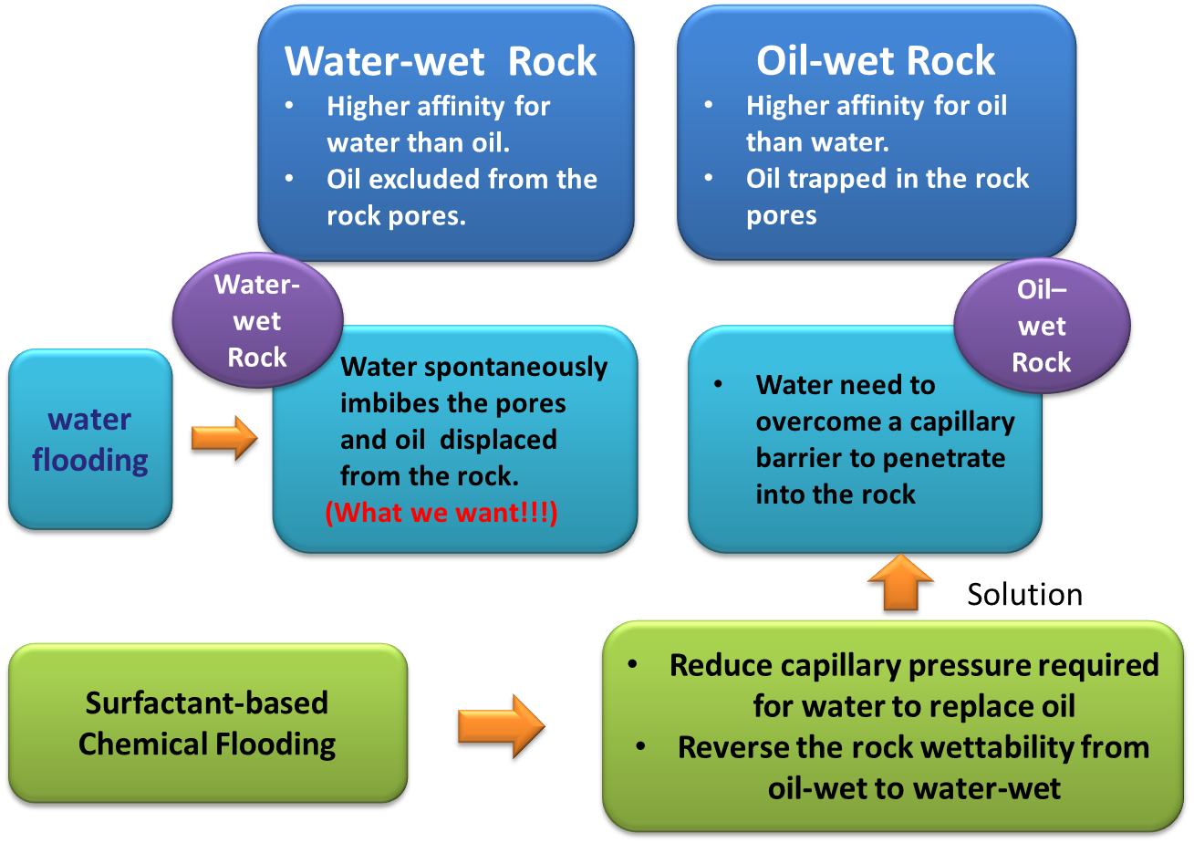
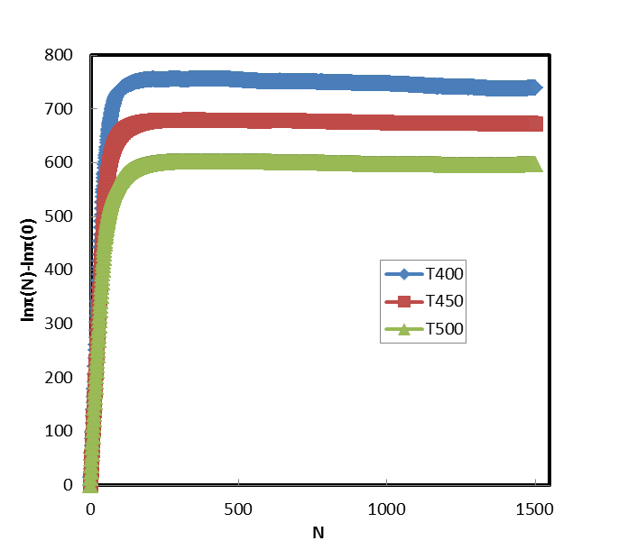
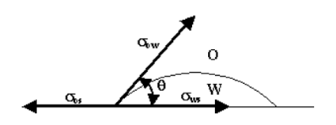
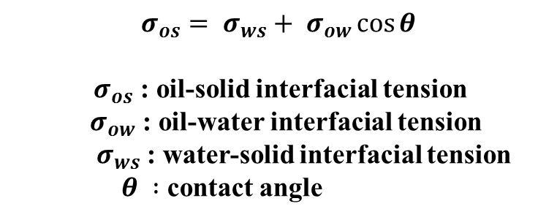
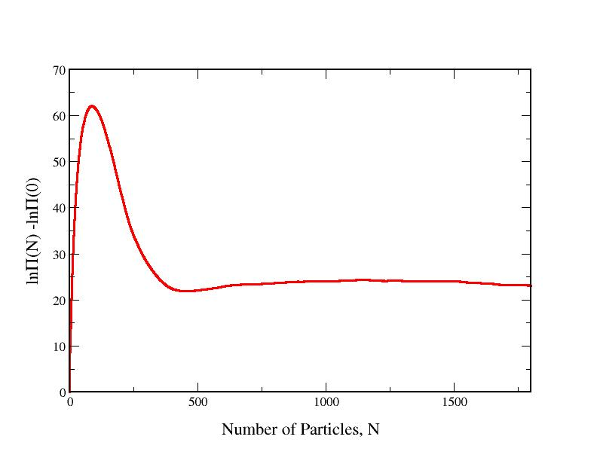



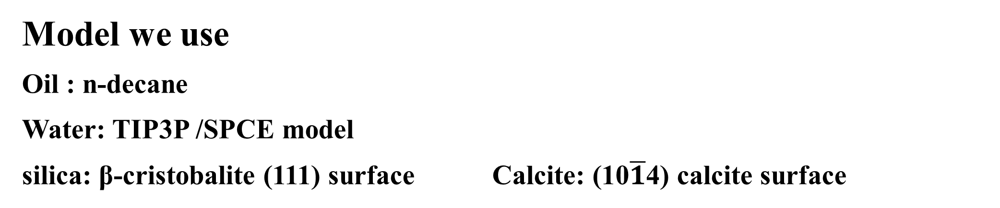
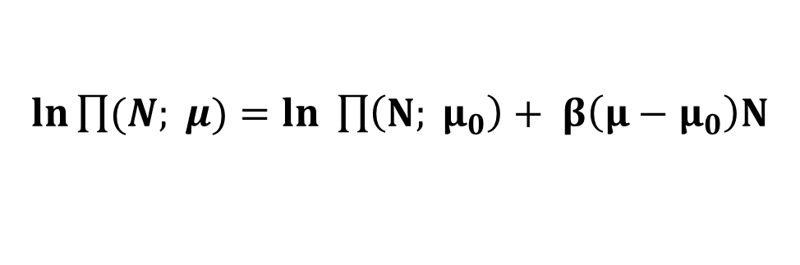
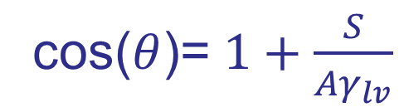

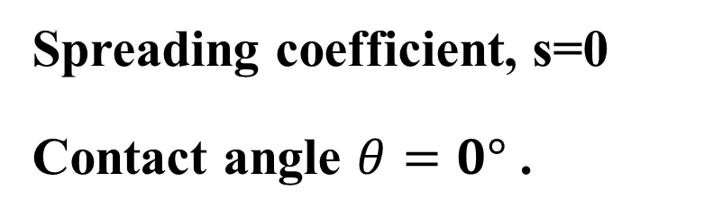
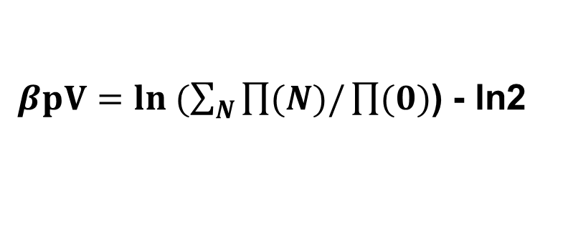
A Comprehensive Molecular-Based Study of the Stability of Clathrate Hydrates
Weisong Lin , Andrew J. Schultz, David A. Kofke
Department of Chemical and Biological Engineering, University at Buffalo
Introduction
With increased oil prices, considerable research has been conducted to evaluate enhanced oil recovery strategies for improving oil recovery. One method that has received considerable attention is surfactant-based chemical flooding. A better understanding of this chemical treatment is needed to increase oil production. In our study, we use Monte Carlo simulations to study the interfacial phenomena related to the enhanced oil recovery (EOR).
Oil Recovery
Primary recovery: Nature process
Secondary recovery: Gas or water injection
to maintain pressure. (Still 50%-70%
oil remain in the well . That’s why EOR
is so important)
Tertiary Recovery (EOR):
Mobilize oil and extract up to 50% of the remaining oil .
Oil reservoir
Porous rock surrounded by oil and water.
What EOR do :
Get oil out from the pore of the rock.
Rock Characteristic:
What we want to study?
1)Oil-water interface
Factor: surfactant identity and concentration
Interfacial properties : Interfacial tension
2) rock/oil/water interface
Rock: calcite and silica
Factor: surfactant & Carboxylic acid (heavy asphaltene fractions of crude oil )
Interfacial properties: Contact angle ; interfacial tension .
2. Temperature Expanded Ensemble techniques
Why we need this technique?
The sampling problems occur when the system is at low temperature.
Strategy:
Carry the complete GCMC simulations at conditions of high temperature and get the free energy profile.
Use Expanded Ensemble techniques to derive free energy profiles at lower temperatures with the information from GCMC simulations.
Preliminary Result
Bulk simulation:
Interfacial simulation:
Model we use
Oil : n-decane
Water: TIP3P /SPCE model
silica: β-cristobalite (111) surface Calcite: (10$\overline{1}$4) calcite surface
Water model
Saturation chemical potential
Pore where oil and water can flow freely
$ln\prod{(N; μ)}=ln \prod{\left(N; μ_{0}\right)+ β\left(μ−μ_{0}\right)N}$
Saturation pressure
Oil reservoir
$βpV=ln (\sum_{N}{\prod{(N)/\prod{(0)}}}$) - ln2
Particle number probability distribution at Liquid vapor coexistence conditions
Silica surface
Red: oxygen White: hydrogen
Yellow: silicon
Calcite surface
Red: oxygen Green: Carbonate Grey: carbon
Simulation Method
1. Grand Canonical Transition Matrix Monte Carlo
(GC-TMMC)
Principle: volume, chemical potential and temperature are held constant and the particle number and energy fluctuate. Transitions between states of different density are monitored.
Simulations are done at liquid – vapor co-existence conditions.
What we will get:
1)Density probability distribution П(N)
2) Surface excess free energy : $V=−KTln$П(N)
2)The spreading coefficient (S) : The difference between the peak and plateau region in density probability distribution figure.
3)Contact angle can be obtained from spreading coefficient.
Spreading coefficient, s=0
Contact angle $θ=0°$ .
The calcite surface is completely wetting.
Particle number probability distribution at calcite-water interface
Future work
To study wetting behavior of water with other calcite models.
To study wetting behavior of water on silica surface.
To study the wetting behavior of n-decane on calcite and silica surface.
To study how carboxylic acid influence a single fluid(water or decane) at a rock surface with the information of rock-water and rock-decane interfacial properties.
Terminology
Wettability: The preference for one fluid to spread on or adhere to a solid surface in presence
Wetting phase: The fluid with higher affinity for the solid surface.
Contact angle:
Capillary pressure: Difference in the pressure between two fluids measure at the interface between two immiscible fluids. In our case, work against the interfacial tension between oil and water phases.
$$β\text{S}\text{ = }βA\left[γ_{sv}−\left(γ_{sl}+ γ_{lv}\right)\right]$$
$$=−ln⁡[\frac{\prod{ (N_{vapor} ; μ_{sat})}}{ \prod{ (N_{plateau }; μ_{sat})}}]$$
Force balance at the three phase contact line
Research funded by: Computation aided by:
cos($θ$)= $1+\frac{S}{Aγ_{lv}}$
Particle number distribution at interface

